Slide 1

ECE 1710: Power Distribution Systems Engineering and Smart Grids
Lecture 3
Dr. Robert Kerestes
University of Pittsburgh
Swanson School of Engineering
Department of Electrical and Computer Engineering
Notes:
Instructions for editing school and department titles:
Select from menu: View > Master > Slide Master
Click on each text area you wish to edit. Text will become editable.

Slide 2
Outline
Module #1: Individual Customer Load
Module #2: Distribution transformer loading
Module #3: Feeder load
Module #4: Transformer Calculations
Module #5: Voltage Drop Example

Slide 3
Learning Objectives
Learning Objectives:
Calculate energy demand, average power, and load factor for an individual customer
Perform circuit analysis using a distribution transformer
Calculate the load duration curve for a given distribution transformer
Calculate the utilization factor for a distribution transformer
Define a distribution feeder and its associated terminology
Calculate voltage drop along a distribution lateral using transformer loading

Slide 4
Individual Customer Load

Slide 5
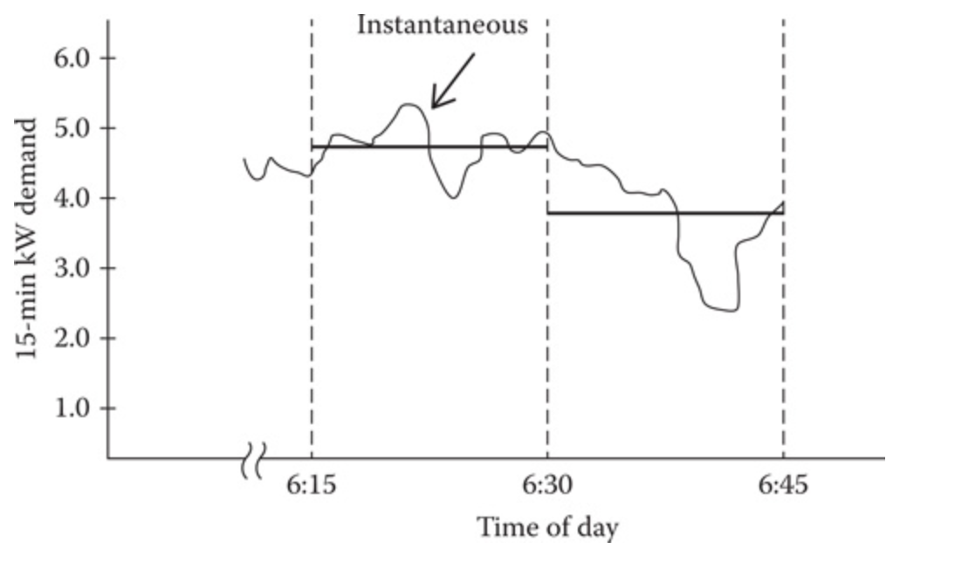
Individual Customer Load
Customer demand curve

Slide 6
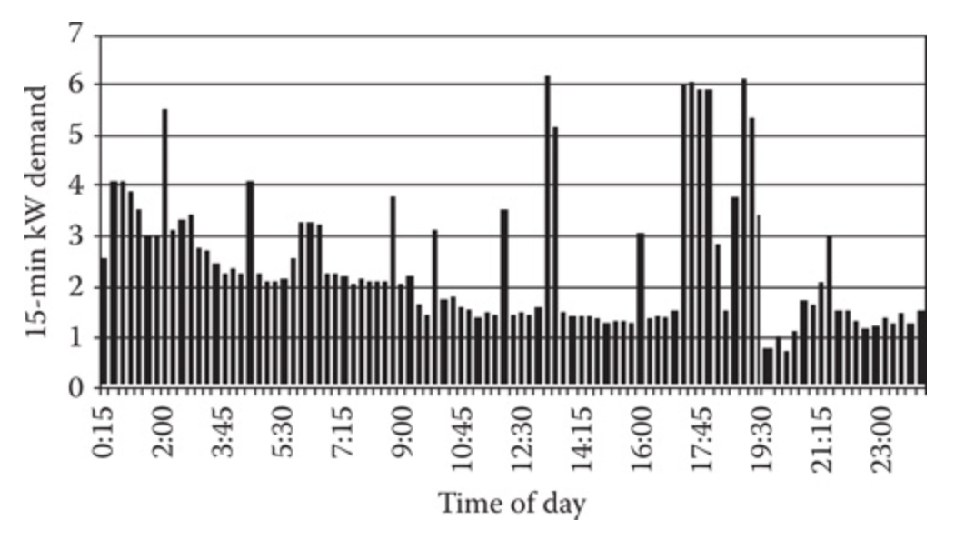
Individual Customer Load
It can be seen in the twenty-four-hour demand that there is a 15-minute maximum kW demand which occurs at 13:15 and has a value of
6.18 kW.
Twenty-four hour demand curve for customer #1

Slide 7
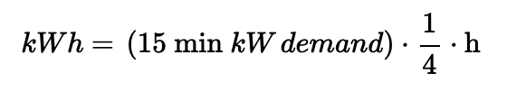
Individual Customer Load
During the 24 hour period, energy (kWh) will be consumed. The energy in kWh used during each 15 minute interval is computed by:

Slide 8
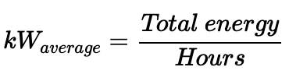
Individual Customer Load
The total energy consumed during the day is the summation of all of the15 min interval consumptions. The 15 min average kW demand is computed by:

Slide 9
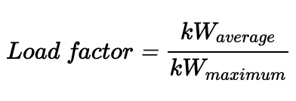
Individual Customer Load
Load factor is a term that is often referred to when describing a load. It is defined as the ratio of the average demand to the maximum demand.
Load factor gives an indication of how well the utility's facilities are being utilized. From the utility's standpoint, the optimal load factor would be 1.00 since the system has to be designed to handle the maximum demand.

Slide 10
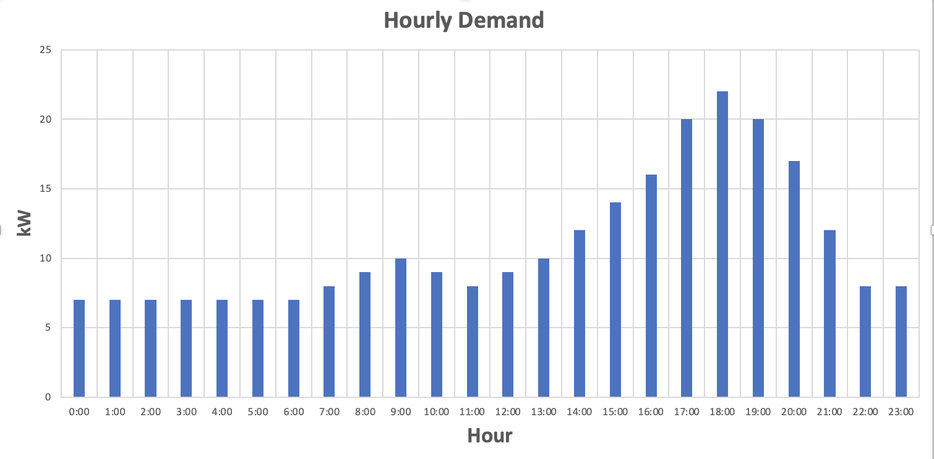
Example: For the the individual load above (easiest with Excel)
Calculate the kWh consumed for the day
Calculate the average kW demand for the day, round to two decimal places
Calculate the load factor, round to two decimal places

Slide 11
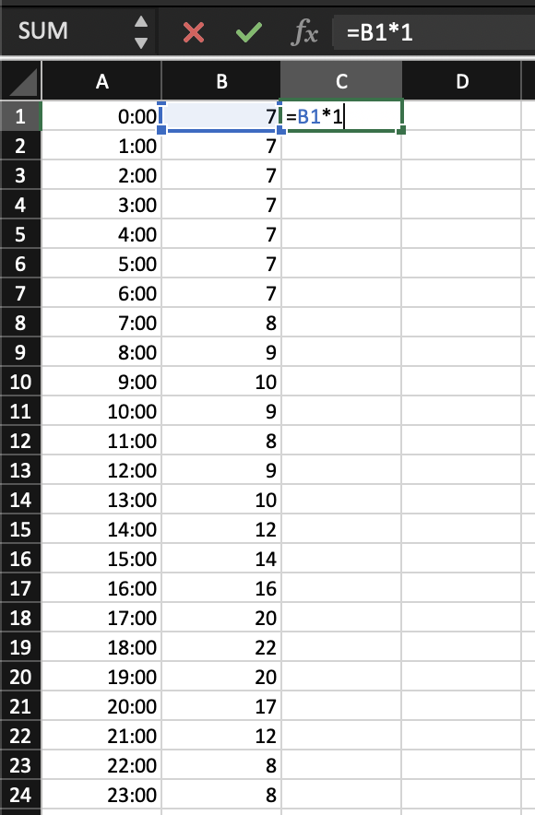
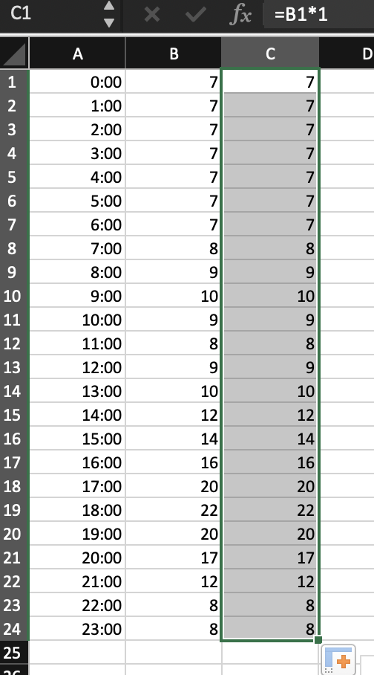
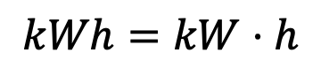
$$kWh=kW⋅h$$

Slide 12
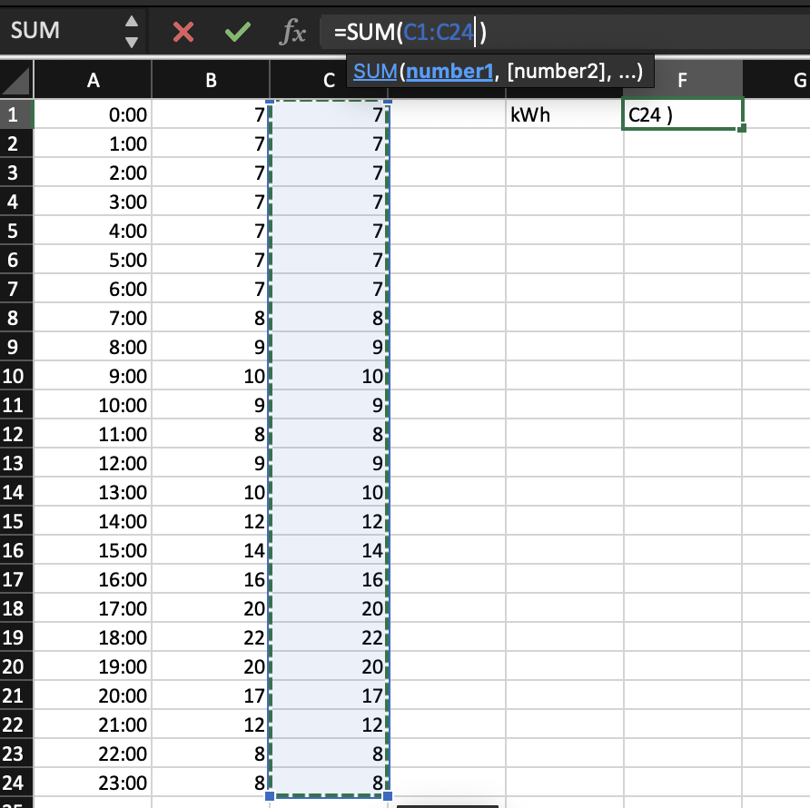
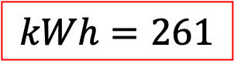
$$kWh=kW⋅h$$
$$kWh=261$$

Slide 13
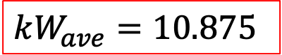
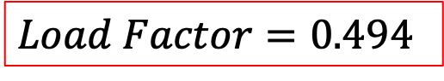
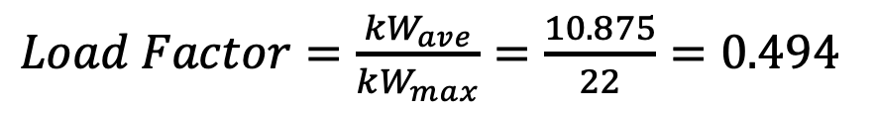
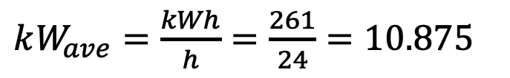
$kW_{ave}=\frac{kWh}{h}=\frac{261}{24}=10.875$
$kW_{ave}=10.875$
$Load Factor=\frac{kW_{ave}}{kW_{max}}=\frac{10.875}{22}=0.494$
$Load Factor=0.494$

Slide 14
Distribution transformer loading

Slide 15
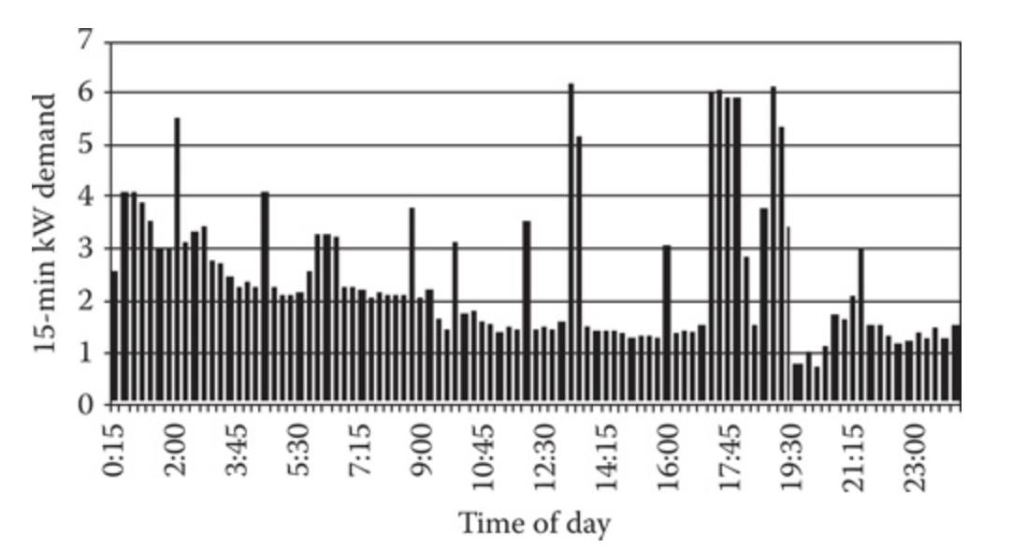
Distribution Transformer Loading:
A distribution transformer will provide service to one or more customers. Each customer will have a demand curve like that of customer #1.
Twenty-four hour demand curve for customer #1

Slide 16
Distribution Transformer Loading:
The peaks and valleys and maximum demands will be different for each customer. Customers #2 through #4 are shown on the next three slides to illustrate this.

Slide 17
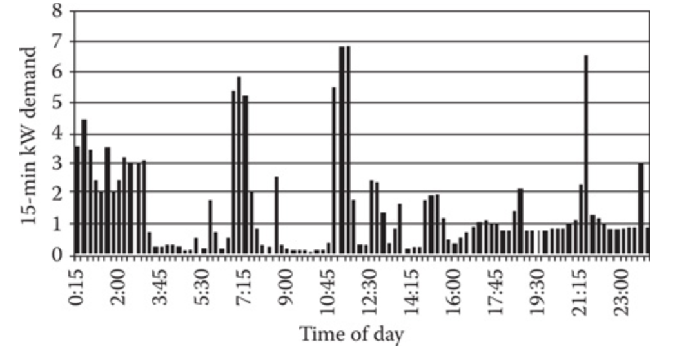
Distribution Transformer Loading:
Twenty-four hour demand curve for customer #2

Slide 18
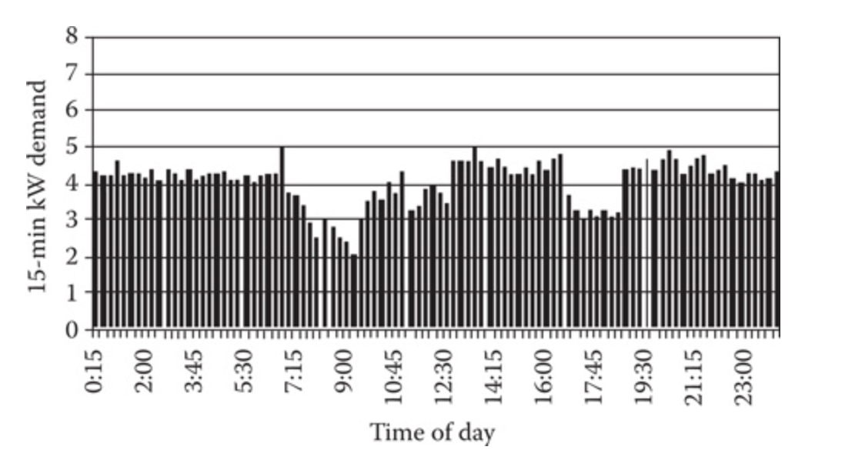
Distribution Transformer Loading:
Twenty-four hour demand curve for customer #3

Slide 19
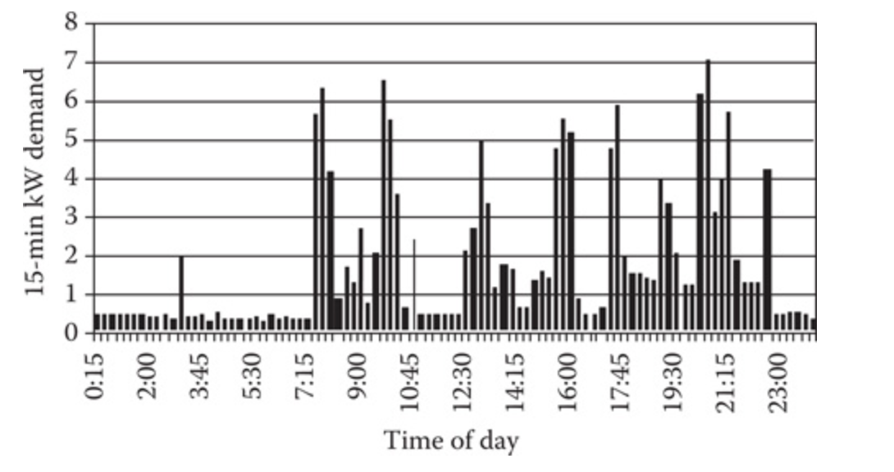
Distribution Transformer Loading:
Twenty-four hour demand curve for customer #4

Slide 20
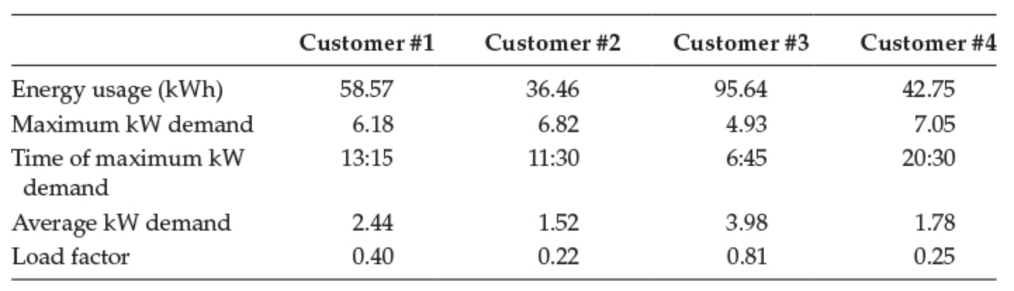
Distribution Transformer Loading:
A summary of individual loads is given in the table below. The four customers given demonstrate that there is great diversity between their loads.
Individual customer load characteristics

Slide 21
Distribution Transformer Loading:
It is assumed that the same distribution transformer serves the four customers discussed previously. The sum of the four 15 kW demands for each time interval is the diversified demand for the group in that time interval, and in this case, the distribution transformer.

Slide 22
Distribution Transformer Loading:
The diversified demand curve can be seen on the next slide. For this particular case, the 15 min maximum diversified kW demand of the transformer occurs at 17:30 and has a value of 16.16 kW.

Slide 23
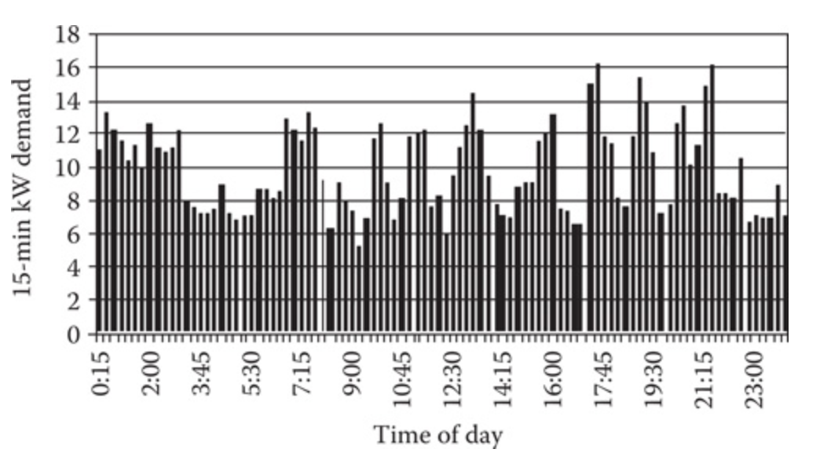
Distribution Transformer Loading:
Transformer diversified demand curve

Slide 24
Distribution Transformer Loading:
A load duration curve can be developed for the transformer serving the four customers. This is sorted in descending order and shown on the next slide.
The load duration curve plots the 15 min kW demand versus the percent of time the transformer operates at or above the specific kW demand.
Dr. Robert

Slide 25
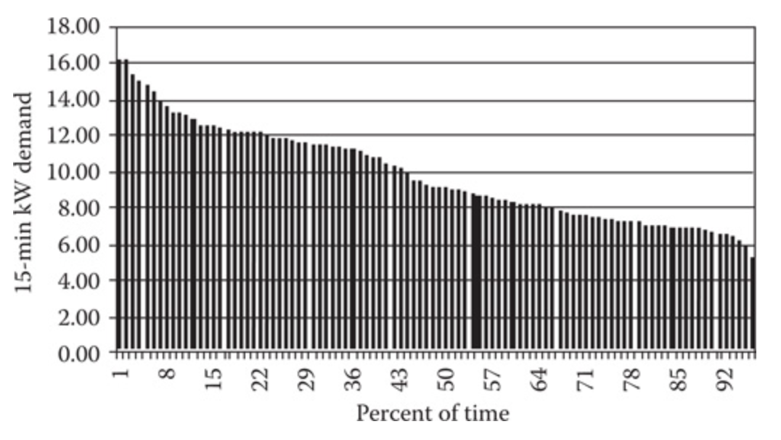
Distribution Transformer Loading:
Transformer load duration curve

Slide 26
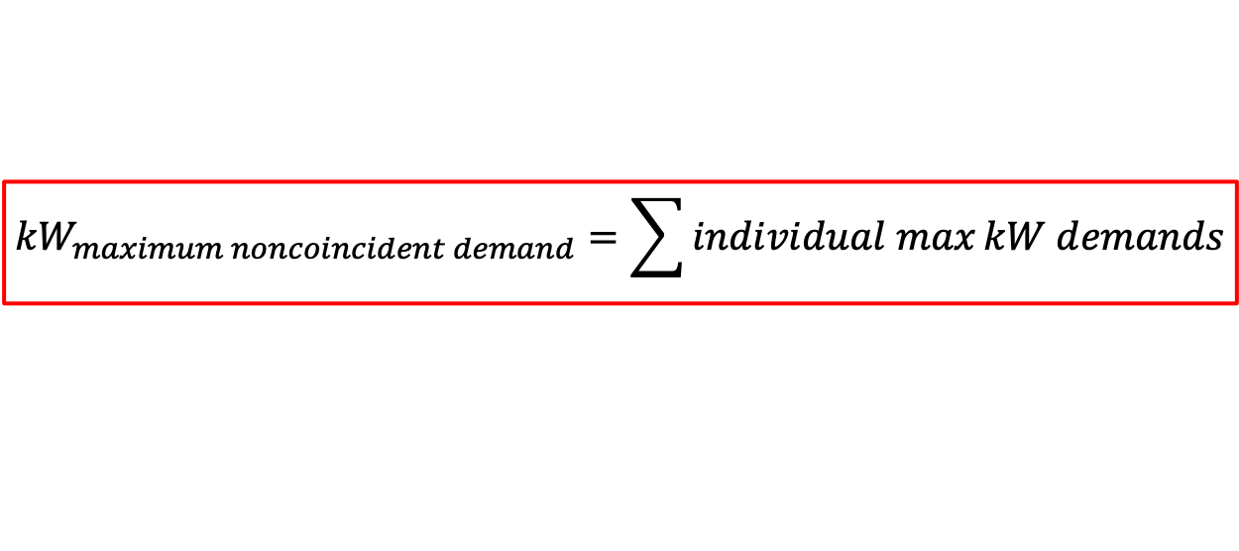
Distribution Transformer Loading:
The 15 min maximum noncoincident kW demand for the day is the sum of the individual customer 15 min maximum kW demands.
$${kW}_{maximum noncoincident demand}=\sum{individual max}kW demands$$
Example:

Slide 27
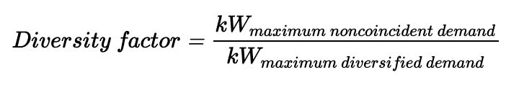
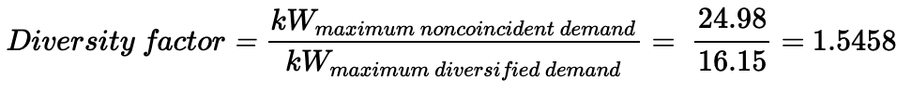
Distribution Transformer Loading:
The diversity factor (DF) is the ratio of the maximum noncoincident demand of a group of customers to the maximum diversified demand of the group. This is given by the equation
Example:

Slide 28
Distribution Transformer Loading:
The idea behind the DF is that when the maximum demands of the customers are known, then the maximum diversified demand of a group of customers can be computed. There will be a different value of the DF for different numbers of customers.

Slide 29
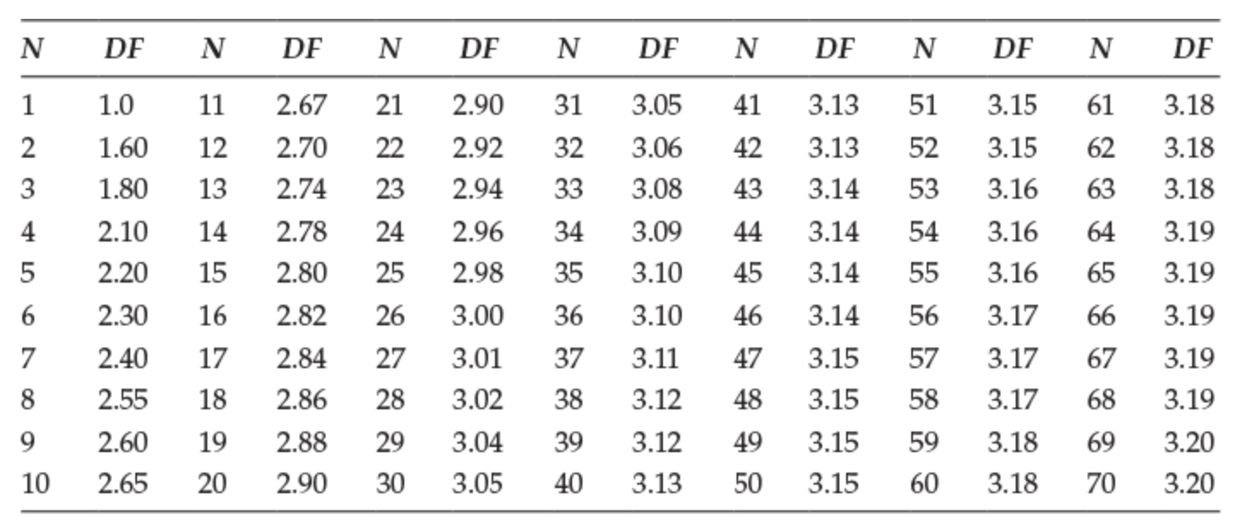
Distribution Transformer Loading:
Diversity factors

Slide 30
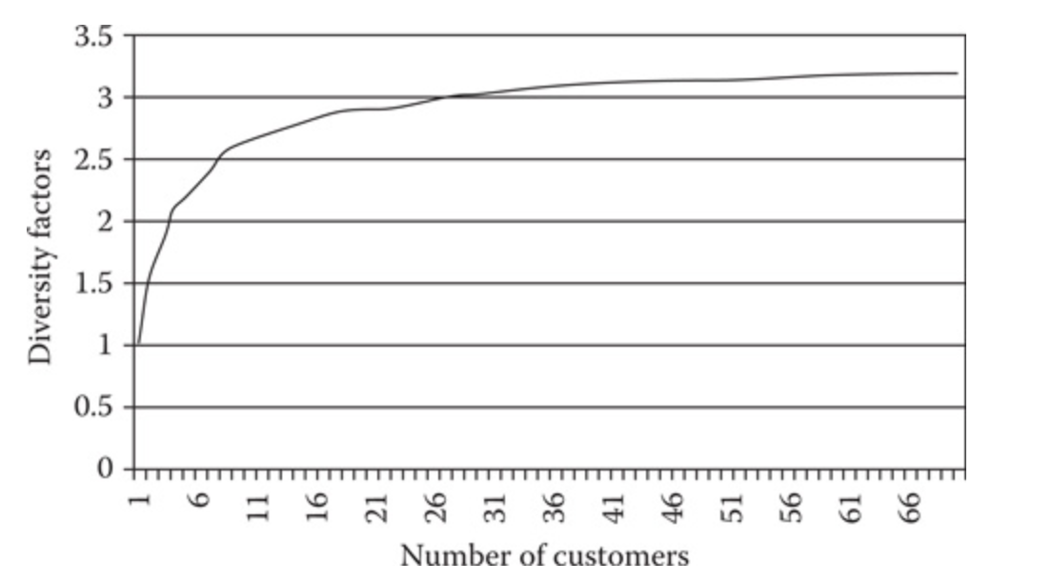
Distribution Transformer Loading:
Diversity factors

Slide 31
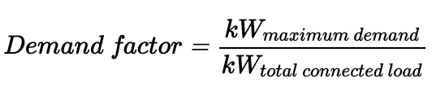
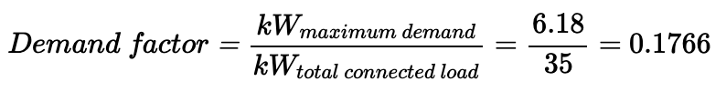
Distribution Transformer Loading:
The demand factor can be defined for an individual customer. In order to determine the demand factor, the total connected load of the customer needs to be known. The total connected load will be the sum of the ratings of all of the electrical devices at the customer's location:
The demand factor gives an indication of the percentage of electrical devices that are on when the maximum demand occurs.
Example:

Slide 32
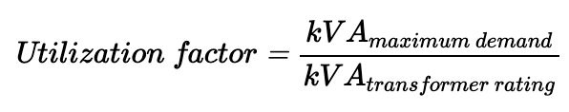
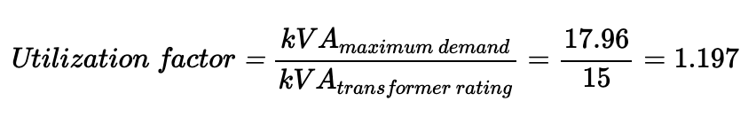
Distribution Transformer Loading:
The utilization factor gives an indication of how well the capacity of an electrical device is being utilized:
Example:

Slide 33
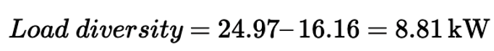
Distribution Transformer Loading:
Load diversity is defined as the difference between the noncoincident maximum demand and the maximum diversified demand.
$$Load Diversity =kW maximun noncoincident demand −kW maximum diverisified demand$$
Example:

Slide 34
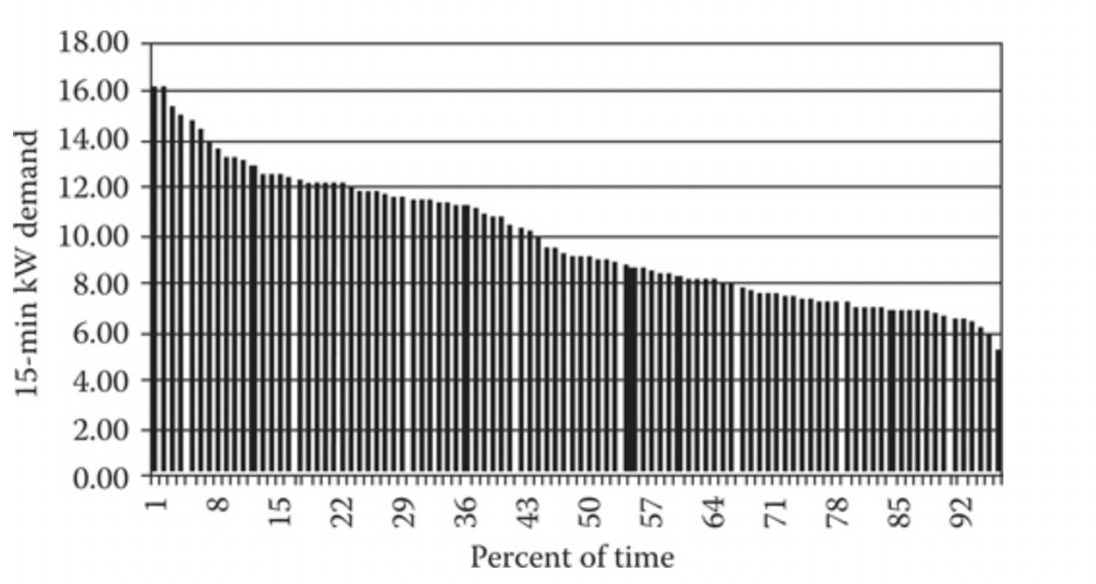
Distribution Transformer Loading:
Question: Using the following load duration curve, what percentage of the time is the transformer loaded over 10 kW?

Slide 35
Distribution Transformer Loading:
Question: Using the following load duration curve, what percentage of the time is the transformer loaded under 4 kW?

Slide 36
Feeder load

Slide 37
Feeder Load
The load that a feeder serves will display a smoothed-out demand curve as can be seen on the next slide.
The feeder demand curve does not display any of the abrupt changes in demand of an individual customer demand curve or the semi-abrupt changes in the demand curve of a transformer.

Slide 38
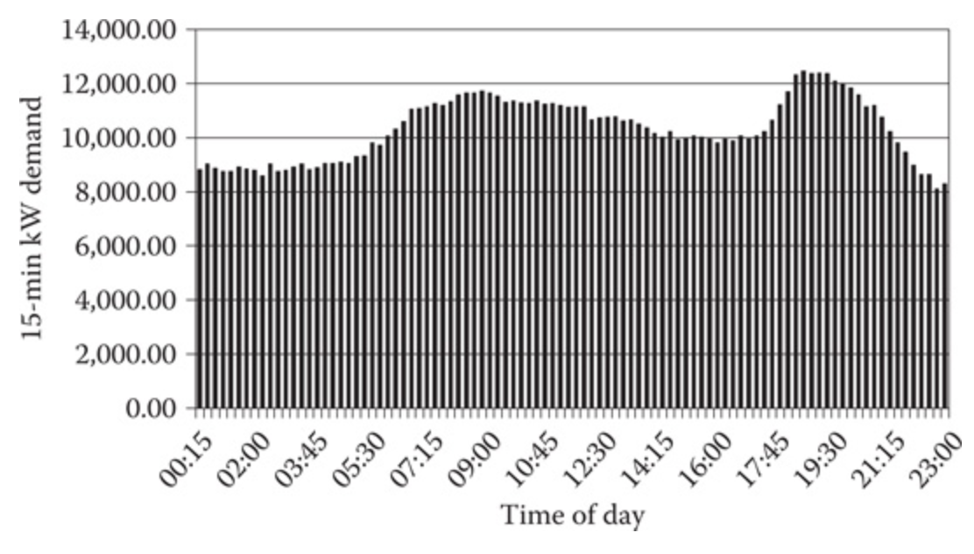
Feeder Load
Feeder demand curve

Slide 39
Feeder Load
In the analysis of a distribution feeder, "load" data will have to be specified. This can range depending on the level of detail the feeder needs modeled.

Slide 40
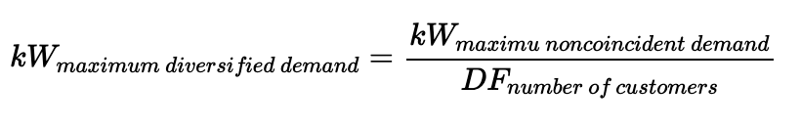
Feeder Load
When a table is available which shows the diversity factors as a function of the total customers, it is possible to determine the maximum diversified demand of a group of customers such as those served by a distribution transformer. This can be computed by:

Slide 41
Feeder Load
Many times the maximum demand of individual customers will be known either from metering or from knowledge of the energy (kWh) consumed by the customer. Some utility companies will perform a load survey of similar customers in order to determine the relationship between the energy consumption in kWh and the maximum kW demand.
However, today this can be determined using an advanced meter interface (AMI) or otherwise known as a smart meter

Slide 42
Feeder Load
At the end of the survey period, the maximum demand versus kWh for each customer can be plotted on a common graph. Linear regression is used to determine the equation of a straight line that gives the kW demand as a function of kWh. A linear regression form 15 customers is
shown on the next slide.

Slide 43
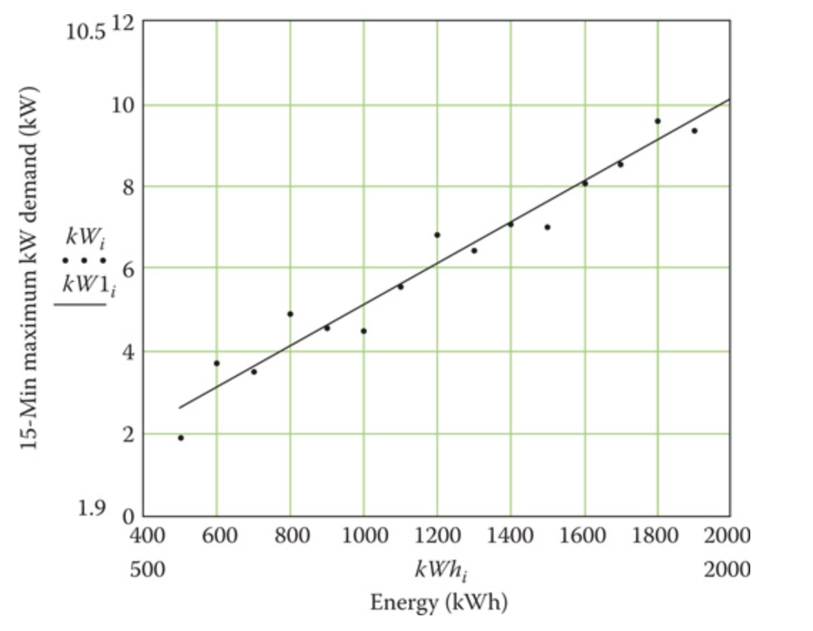
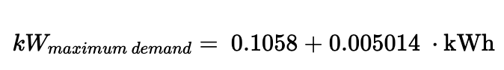
Feeder Load
Which produces the straight-line equation:
KW demand versus kWh for residential customers

Slide 44
Feeder Load
To develop a table of DF's
Find the maximum demand for each customer
Perform a load survey where the maximum diversified demand of groups of customers is metered.

Slide 45
Feeder Load
A transformer load management program is used by utilities to determine the loading on distribution transformers based upon a knowledge of the kWh supplied by the transformer during a peak loading month.
The transformer load management program relates the maximum diversified demand of a distribution transformer to the total kWh supplied by the transformer during a specific month.

Slide 46
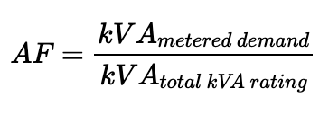
Feeder Load
The kVA ratings of all distribution transformers are always known for a feeder. The metered readings can be allocated to each transformer based upon the transformer rating. An allocation factor (AF) can be determined based upon the metered three-phase kW or kVA demand and
the total connected distribution transformer kVA:

Slide 47
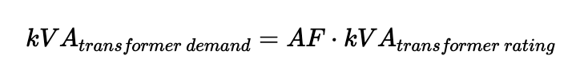
Feeder Load
The allocated load per transformer is then determined by:

Slide 48
The transformer demand can be in either kW or kVA, depending upon the metered quantity.
When kW or kVA is metered by phase, then the load can be allocated by phase where it will be necessary to know the phasing of each distribution transformer.
When maximum current per phase is metered the load allocated to each distribution transformer can be done by assuming nominal voltage at the substation and then computing the resulting kVA.
If there is no metered information on the reactive power or power factor of the feeder, a power factor will have to be assumed for each transformer load.

Slide 49
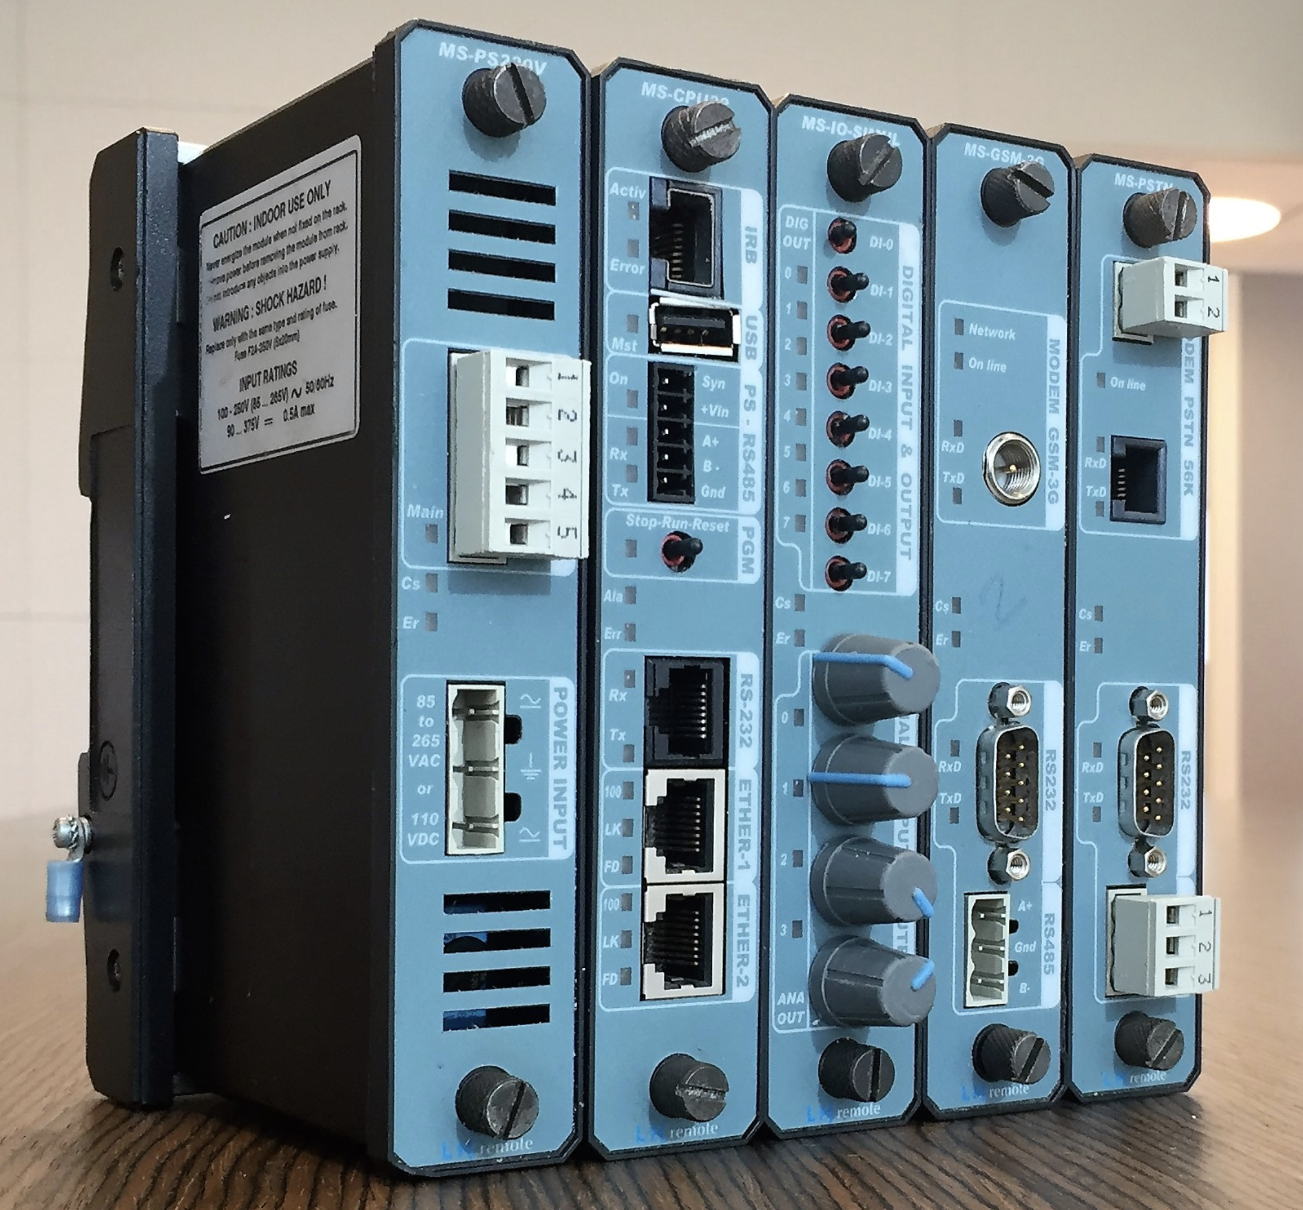
Modern substations will have microprocessor-based metering using remote terminal units (RTUs) that will provide kW, kvar, kVA, power factor, and current per phase. With this data, the reactive power can also be allocated.

Slide 50
Feeder Load
Which of the following four methods should be used?
Application of DFs
Load survey
Transformer load management
Metered feeder max demand
The answer is dependent on the analysis!

Slide 51
Feeder Load
For example, if the purpose of the analysis is to determine as closely as possible the maximum demand on a distribution transformer then we can use
Application of DFs
Transformer load management
If the analysis is of the total feeder, then neither of these should be performed

Slide 52
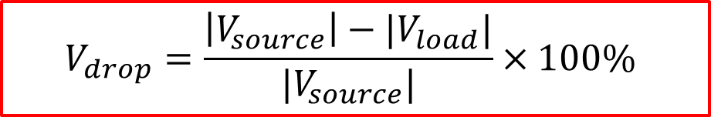
Feeder Load
The voltage drops down line segments and through distribution transformers are of interest to the distribution engineer. The voltage drops can be calculated using the methods of allocating loads.
Voltage drop can be calculated using
$$V_{drop}=\frac{\left|V_{source}\right|−|V_{load}|}{|V_{source}|}×100\%$$

Slide 53
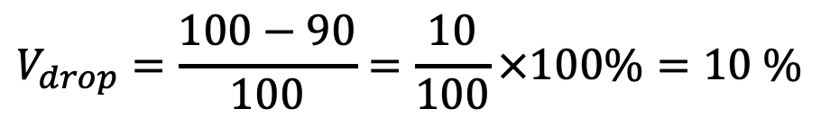
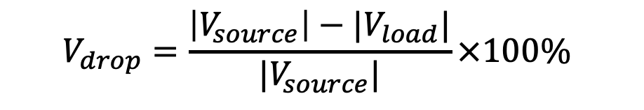

Feeder Load
Example: If a source measures to be 100 V rms, and a load measures to be 90 V rms, please calculate the voltage drop percentage
$$V_{drop}=\frac{\left|V_{source}\right|−|V_{load}|}{|V_{source}|}×100\%$$
$$V_{drop}=\frac{100−90}{100}=\frac{10}{100}×100\%=10 \%$$
$$V_{drop}=10 \%$$

Slide 54
Transformer Calculations

Slide 55
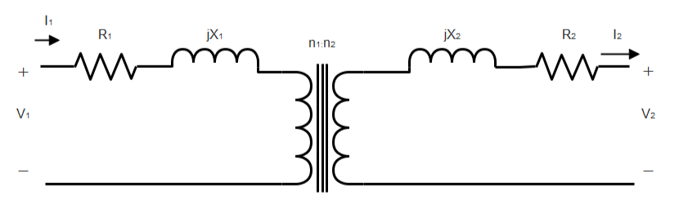
Transformer Calculations
You may recall from circuits class or a class in power the model of a real transformer.
However, only a very basic model of a transformer is needed to perform voltage drop calculations.

Slide 56
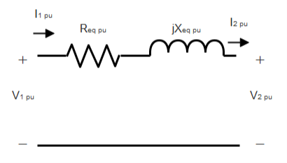
Transformer Calculations
Using the per-unit system we can simplify a transformer to the following circuit. Where pu stands for the per-unit or percentage value.

Slide 57
Transformer Calculations
The voltages, currents and impedances are given in percentage of a base value.
The base values are given by the ratings of the transformer, and we need base values for both the high side and low side quantities.

Slide 58
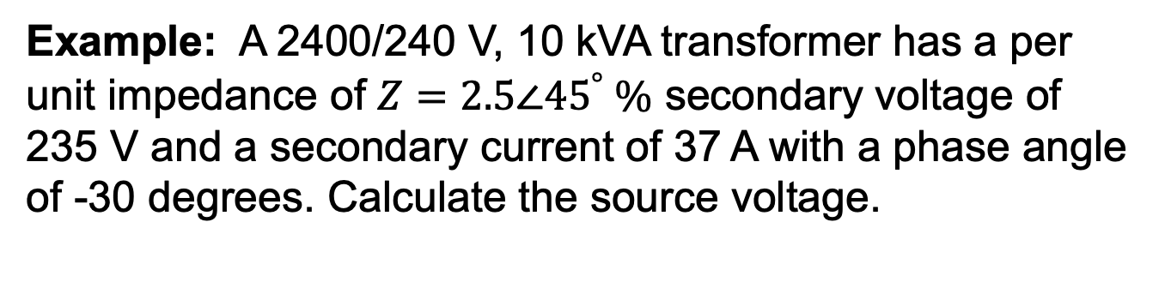
Transformer Calculations
Example: A 2400/240 V, 10 kVA transformer has a per unit impedance of $Z=2.5∠{45}^{°} \text{\%}$ secondary voltage of 235 V and a secondary current of 37 A with a phase angle of -30 degrees. Calculate the source voltage.

Slide 59
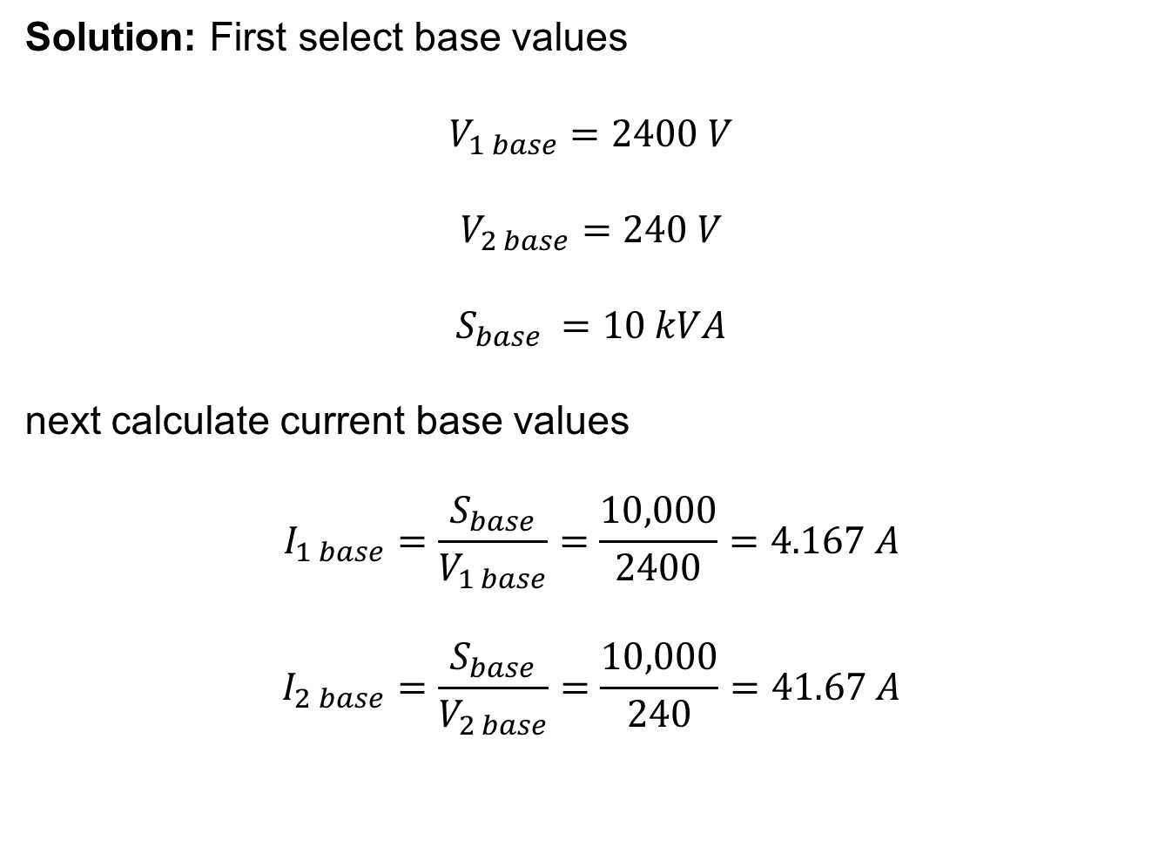
Transformer Calculations
Solution: First select base values
$$V_{1 base}=2400 V$$
$$V_{2 base}=240 V$$
$$S_{base }=10 kVA$$
next calculate current base values
$$I_{1 base}=\frac{S_{base}}{V_{1 base}}=\frac{10,000}{2400}=4.167 A$$
$$I_{2 base}=\frac{S_{base}}{V_{2 base}}=\frac{10,000}{240}=41.67 A$$

Slide 60
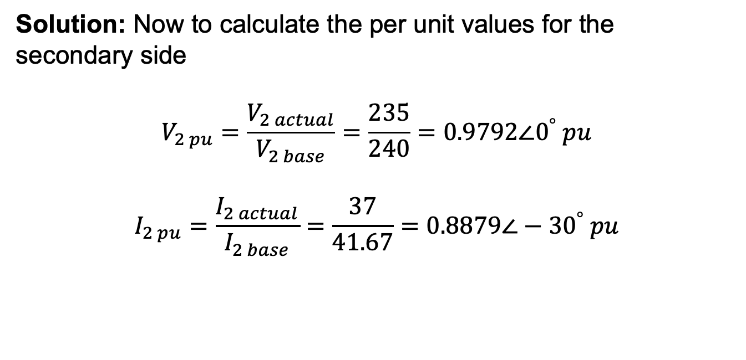
Transformer Calculations
Solution: Now to calculate the per unit values for the secondary side
$$V_{2 pu}=\frac{V_{2 actual}}{V_{2 base}}=\frac{235}{240}=0.9792∠0^{°} pu$$
$$I_{2 pu}=\frac{I_{2 actual}}{I_{2 base}}=\frac{37}{41.67}=0.8879∠−30^{°} pu$$

Slide 61
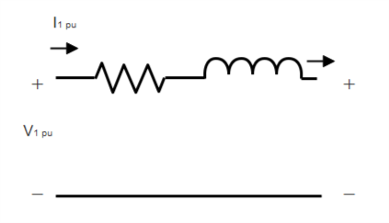
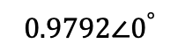


Transformer Calculations
Solution: Performing KVL on the circuit
$$0.025 ∠{45}^{°}$$
$$0.8879∠−30^{°}$$
$$0.9792∠0^{°}$$
$$V_{1 pu}=Z_{pu}I_{2 pu}+V_{2 pu}$$
$=(0.025 ∠{45}^{°})(0.8879∠−30^{°}$)+ $0.9792∠0^{°}$
$$=1.0007∠0.329^{°} pu$$

Slide 62

Transformer Calculations
Solution: Converting the per unit value back to its actual value
$$V_{1 actual}=V_{1 pu}V_{1 base}$$
$$=1.0007∗2400$$
$$=2401.7 V$$
and the per-unit value and actual value have the same phase angle so
$$V_{1}=2401.7∠0.329^{°}V$$

Slide 63



Transformer Calculations
Now let’s take a look at the transformer impedance to show a very interesting result. The impedance for the transformer is $Z=0.025∠{45}^{°} pu$
If we use a high side base:
$$Z_{1 base}=\frac{V_{1 base}^{2}}{S_{base}}=\frac{{2400}^{2}}{10,000}=576 Ω$$
$$Z_{1 actual}=Z_{1 base}Z_{1 pu}=\left(576\right)\left(0.025∠{45}^{°}\right)=14.4 Ω$$
If we use a low side base:
$$Z_{2 base}=\frac{V_{2 base}^{2}}{S_{base}}=\frac{{240}^{2}}{10,000}=5.76 Ω$$
$$Z_{2 actual}=Z_{2 base}Z_{2 pu}=\left(5.76\right)\left(0.025∠{45}^{°}\right)=0.144 Ω$$

Slide 64
Transformer Calculations
So which is it??

Slide 65
Voltage Drop Example

Slide 66



Slide 67

The maximum diversified demands
Segment N1-N2, Loads 1-18: $P_{12}$ = 92.9 kW
Segment N2-N3, Loads 6-18: $P_{23}$ = 72.6 kW
Segment N3-N4, Loads 12-18: $P_{34}$ = 49.0 kW
Transformer T1, Loads 1-5: $P_{T1}$ = 30.3 kW
Transformer T2, Loads 6-11: $P_{T2}$ = 35.5 kW
Transformer T3, Loads 12-18: $P_{T3}$ = 49.0 kW

Slide 68
Calculating the associated apparent power
Segment N1-N2, Loads 1-18: $S_{12}=\frac{P_{12}}{pf}=\frac{92.9}{0.9}=103.2$ kVA
Segment N2-N3, Loads 6-18: $S_{23}=\frac{P_{23}}{pf}=\frac{72.6}{0.9}=80.7$ kVA
Segment N3-N4, Loads 12-18: $S_{34}=\frac{P_{34}}{pf}=\frac{49}{0.9}=54.4$ kVA
Transformer T1, Loads 1-5: $S_{T1}=\frac{P_{T1}}{pf}=\frac{30.3}{0.9}=33.7$ kVA
Transformer T2, Loads 6-11: $S_{T2}=\frac{P_{T2}}{pf}=\frac{35.5}{0.9}=39.4$ kVA
Transformer T3, Loads 12-18: $S_{T3}=\frac{S_{T3}}{pf}=\frac{49}{0.9}=54.4$ kVA

Slide 69
Calculating the segment impedances
Segment N1-N2: $\left(\frac{5000}{5280}\right)\left(0.3+j0.6\right)=0.2841+j0.5682 Ω$
Segment N2-N3: $\left(\frac{500}{5280}\right)\left(0.3+j0.6\right)=0.0284+j0.0568 Ω$
Segment N3-N4: $\left(\frac{750}{5280}\right)\left(0.3+j0.6\right)=0.0426+j0.0852 Ω$

Slide 70



Solution: Choosing base values
$$V_{1 base}=2400 V$$
$$V_{2 base}=240 V$$
$$S_{base}=25 kVA$$
$$V_{1 base}=2400 V$$
$$V_{2 base}=240 V$$
$$S_{base}=37.5 kVA$$
T1:
T2:
$$V_{1 base}=2400 V$$
$$V_{2 base}=240 V$$
$$S_{base}=50 kVA$$
T3:

Slide 71



Solution: Calculating current bases, we only need the primary base current
$$I_{1 base}=\frac{25,000}{2400}=10.42 A$$
T1:
$$I_{1 base}=\frac{37,500}{2400}=15.63 A$$
T2:
$$I_{1 base}=\frac{50,000}{2400}=20.83 A$$
T3:

Slide 72



Solution: Calculating the current through segment N1-N2
|$I_{12}|=\frac{S_{12}}{V_{1}}=\frac{103,200}{2400}=43.0 A$
$$∠I_{12}={0−cos}^{−1}{0.9}=−25.84^{°}$$
$$I_{12}=43.0 ∠−{25.84}^{°} A$$

Slide 73



Solution: Using KVL to calculate the voltage at N2
$$V_{2 }=V_{1}−Z_{12}I_{12}=2400−\left(0.2841+j0.5682\right)\left(43.0 ∠−{28.4}^{°}\right)$$
$=2378.4 ∠−{0.4}^{°}$ V

Slide 74





Solution: Calculating the voltage on the low side of T1. First solve for the per unit transformer current
|$I_{T1}|=\frac{S_{T1}}{V_{2}}=\frac{33,700}{2378.4}=14.16 A$
$$∠I_{T1}={−0.4−cos}^{−1}{0.9}=−26.{24}^{°}$$
$$I_{T1}=14.16 ∠−{26.24}^{°} A$$
$$I_{T1 pu }=\frac{I_{T1}}{I_{T1 base}}=\frac{14.16}{10.42}=1.3589$$
$$V_{high T1 pu }=\frac{V_{high T1}}{V_{high T1 base}}=\frac{2378.4}{2400}=0.991 pu$$

Slide 75


Solution: Next use KVL to solve for the per unit voltage on the secondary side of the transformer
$$V_{low T1 pu }=V_{high T1 pu}−Z_{T1 pu}I_{T1 pu}$$
$$=\left(0.991∠{−0.4}^{°}\right)−\left(0.018 ∠{40}^{°}\right)\left(1.3589 ∠−{26.24}^{°}\right)$$
$$=0.9673∠{−0.8}^{°}$$
Converting back to volts
$$V_{low T1}=V_{low T1 base}V_{low T1 pu}=\left(240\right)\left(0.9673∠{−0.8}^{°}\right)$$
$$=232.15∠{−0.8}^{°}$$

Slide 76



Solution: Calculating the current through segment N2-N3
|$I_{23}|=\frac{S_{23}}{V_{2}}=\frac{80,700}{2378.4}=33.9 A$
$$∠I_{23}={−0.4−cos}^{−1}{0.9}=−26.{24}^{°}$$
$$I_{23}=33.9 ∠−{26.24}^{°} A$$

Slide 77


Solution: Using KVL to calculate the voltage at N3
$$V_{3 }=V_{2}−Z_{23}I_{23}=2376.7∠−{0.4}^{°} \text{V}$$

Slide 78





Solution: Calculating the voltage on the low side of T2. First solve for the per unit transformer current
|$I_{T2}|=\frac{S_{T2}}{V_{3}}=16.58 A$
$$∠I_{T2}={−0.4−cos}^{−1}{0.9}=−26.{27}^{°}$$
$$I_{T2}=16.58 ∠−{26.27}^{°} A$$
$I_{T2 pu }=\frac{I_{T2}}{I_{T2 base}}=1.0608$ pu
$$V_{high T2 pu }=\frac{V_{high T2}}{V_{high T2 base}}=\frac{2376.7}{2400}=0.9903 pu$$

Slide 79


Solution: Next use KVL to solve for the per unit voltage on the secondary side of the transformer
$$V_{low T2 pu }=V_{high T2 pu}−Z_{T2 pu}I_{T2pu}$$
$$=0.9712∠{−0.8}^{°}$$
Converting back to volts
$$V_{low T2}=V_{low T2 base}V_{low T2 pu}=\left(240\right)\left(0.9712∠{−0.8}^{°}\right)$$
$$=233.1∠{−0.8}^{°}$$

Slide 80



Solution: Calculating the current through segment N3-N4
|$I_{34}|=\frac{S_{34}}{V_{3}}=\frac{54,500}{2378.4}=22.9 A$
$$∠I_{34}={−0.4−cos}^{−1}{0.9}=−26.{27}^{°}$$
$$I_{34}=22.9 ∠−{26.7}^{°} A$$

Slide 81


Solution: Using KVL to calculate the voltage at N4
$$V_{4 }=V_{3}−Z_{34}I_{34}=2375.0∠−{0.5}^{°} \text{V}$$

Slide 82





Solution: Calculating the voltage on the low side of T3. First solve for the per unit transformer current
|$I_{T3}|=\frac{S_{T3}}{V_{4}}=22.91 A$
$$∠I_{T3}={−0.5−cos}^{−1}{0.9}=−26.{30}^{°}$$
$$I_{T3}=22.91 ∠−{26.30}^{°} A$$
$$I_{T3 pu }=\frac{I_{T3}}{I_{T3 base}}=1.0999$$
$$V_{high T3 pu }=\frac{V_{high T3}}{V_{high T3 base}}=\frac{2376.7}{2400}=0.9896 pu$$

Slide 83


Solution: Next use KVL to solve for the per unit voltage on the secondary side of the transformer
$$V_{low T3 pu }=V_{high T3 pu}−Z_{T3 pu}I_{T3 pu}$$
$$=0.9696 ∠{−1.0}^{°}$$
Converting back to volts
$$V_{low T3}=V_{low T3 base}V_{low T3 pu}=232.7∠{−1.0}^{°}$$

Slide 84


Solution: Calculating the voltage drop percent
$$V_{drop}=\frac{\left|V_{1}\right|−|V_{T3}|}{|V_{1}|}=\frac{2400−2327}{2400}×100\%$$
$$=3.0789 \%$$

